Slide 1
An Overview of Reducing Tribological effects on Wind Turbines
Ryan Pearce, Samer Abdelmoty, Katrina Gualtieri

Slide 2
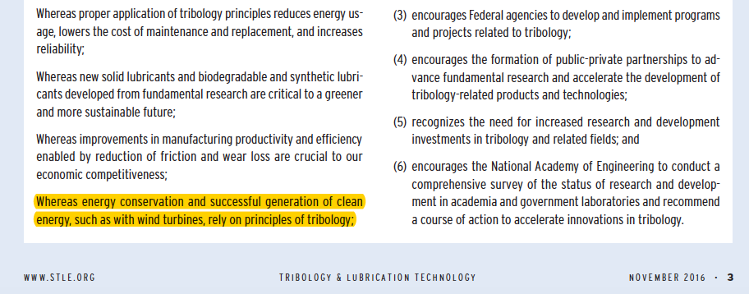
Tribology Resolution
Notes:
0.5min

Slide 3
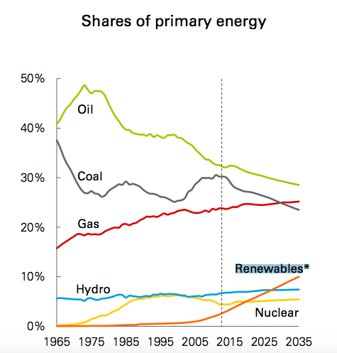
Importance of Energy to the Future
Renewables growing faster than ever
BP Outlook predicts 4x use for power by 2035
Share of global power to jump from 7% in 2015 to 20% by 2035
Competitiveness is key
Only will outproduce if cost is lower
Biggest issues are with tribology

Slide 4
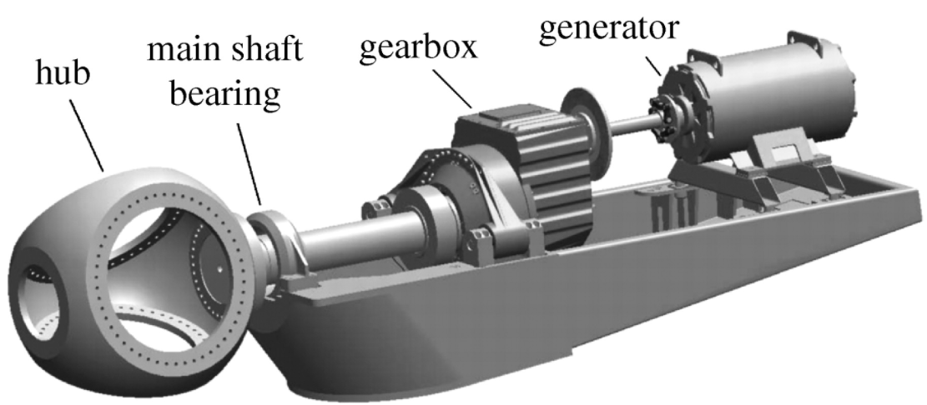
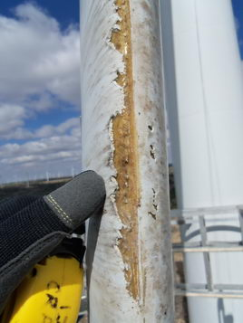
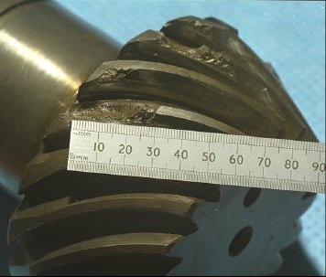
Overview

Slide 5
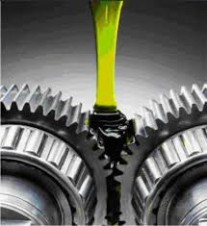
Research to be done
Blades
Drag increase of 80% causes 5% decrease in energy production
Research new coatings to increase hardness
Gearboxes and Bearings
High maintenance cost and large downtime
Research different lubricants, such as CO₂ dissolved in ionic liquids

Slide 6
Windstax Feedback
Main Issues
Bearings
Anti-icing blades
Wear in blades
Proposed Research
Oil coating of bearings
Anti-icing coatings
Different blade materials

Slide 7
Questions?

Slide 8
Extra Slides

Slide 9
Major Issues Overview
Blades
Wear from hail and rain on CFRP outer layer of massive blades, different coatings to increase hardness but keep aerodynamic
Gearboxes
Life span of the gearbox deteriorates because no ideal lubricant can be use with variations in CO2 dissolved in ionic liquids
Main Shaft Bearings
Micropitting occurs and causes wear in spherical roller bearings

Slide 10
Blade Tip Erosion
Blade can increase drag by 6 -500% depending on severity of wear
If drag is increased by 80% annual energy production decreases by 5%
Wear can begin to occur as shortly as 2 years
Potential solutions are Tapes and Coatings
Drawbacks to Tapes are a slight increase in drag coupled with

Slide 11
Gearbox Lubrication
Problem: Failure of gearboxes in wind turbines due to high stress imposed from rotation mechanism over many lifecycles. Lubrication can help prolong the lifespan of the moving parts and reduce tribology inside the box, however it is difficult to determine a “one size fits all” lubricant for varying stresses and temperatures.
Solution: Recent studies have shown proven benefits of using an ionic liquid lubricant with dissolved carbon dioxide to allow for dynamic control of lubricant viscosity.
Highlights:
Why? Want to control the viscosity of the liquid since loads from the wind and temperatures from weather patterns are not consistent in order to protect wind turbines
How? Controlling pressure of the gearbox to affect the CO2 in the lubricant and alter the viscosity
Decreasing pressure increases viscosity at higher loads and increasing pressure decreases viscosity at lower loads
Maximizing the appropriate viscosity of the lubricant to be used, operators can save money replacing parts and ultimately through wasting less energy over time by reducing wear
Additional advantages to the IL-CO2 lubricant:
Reduce power loss and wasted energy
Longer lifespan on parts as well as lubricant
More flexibility and control to accommodate environmental conditions
Ionic liquids have lower friction coefficients
CO2 improves the viscosity index of lubricants
Operators can alter the lubricant without changing it to save time and money

