Slide 1
Lumogenic Light-Based Hospital Sanitation
Samer Abdelmoty, Nabeel Mohamed, Candace Ogata, Daniel Peppler, & Apurva Pradhan
With Dr. Mohammad Islam

Slide 2
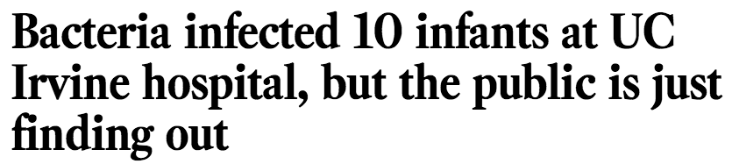

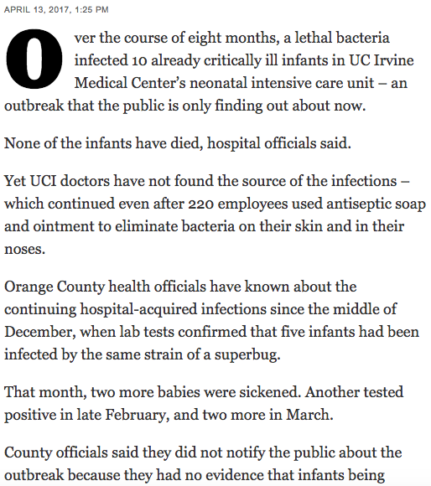
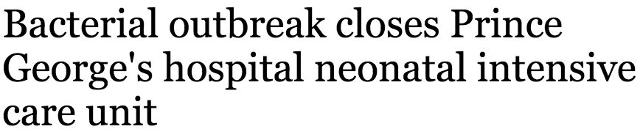
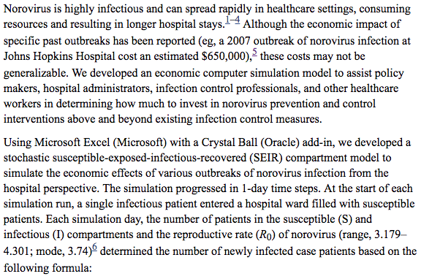

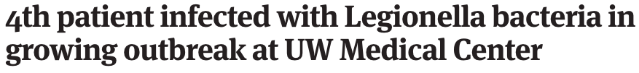
The outbreaks are also costly. A 2010 study found that a MRSA infection extended the infant’s hospital stay by 40 days on average at an additional cost of $160,000.
2007 Outbreak… at Johns Hopkins Hospital cost an estimated $650,000
Notes:
http://www.latimes.com/business/la-fi-uc-irvine-superbug-outbreak-20170413-story.html
UC Irvine Story
https://www.ncbi.nlm.nih.gov/pmc/articles/PMC3385992/#R5
Economic impacts of outbreaks

Slide 3




Healthcare-Acquired Infections Are Still a Big Problem
1 - 2 million preventable healthcare-acquired infections each year in the US
36% increase in HAIs in 2016 due primarily to drug resistant pathogens
90,000 patients die each year from preventable HAIs in the US
$10 - $30 billion is spent yearly by US hospitals to treat HAIs

Slide 4
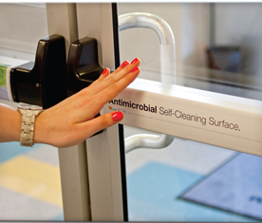
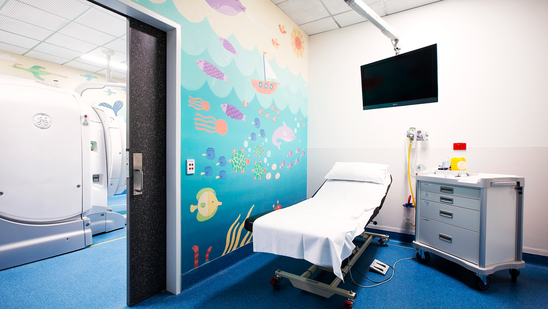
Lumogenic Stickers and Wallpapers Can Mitigate the Risk of Hospital Acquired Infections
Wallpaper
Stickers
Notes:
Potentially put ask of $500,000
To perform infield testing and begin early-stage production

Slide 5
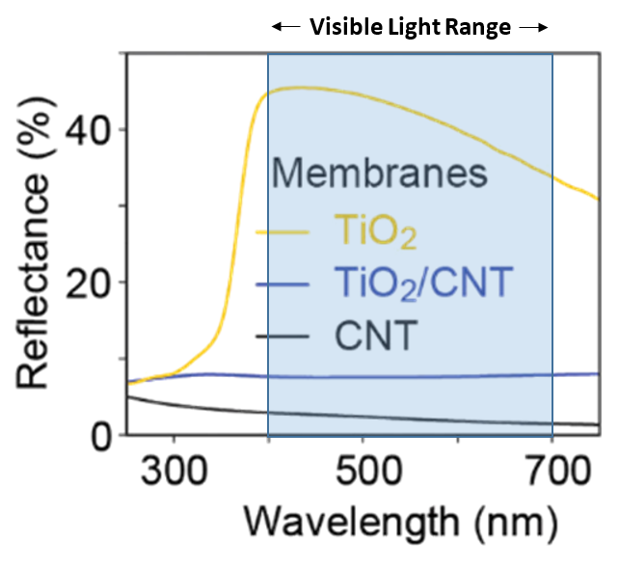
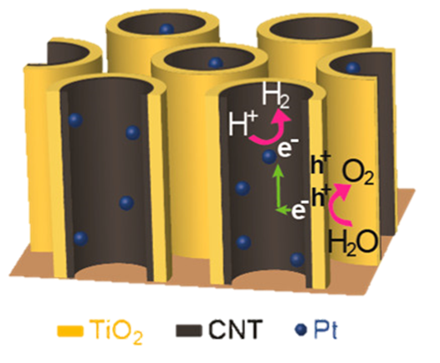
Lumogenic Harnesses the Power of Normal Light to Kill Pathogens
Lower is Better
Secret Sauce!
Patent Pending
Notes:
Secret Sauce

Slide 6
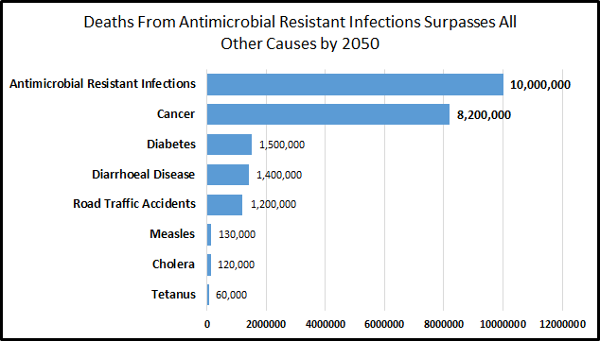



Lumogenic Kills and Prevents Drug Resistant Bacteria
Fewer Superbugs
Pathogens will not develop a resistance to electrons
Cancer
Diabetes
Diarrhoeal Disease
Not Strain Specific
No pathogen is immune to this type of sanitation
Road Traffic Accidents
Measles
Operates in Indoor Lighting
Cholera
Tetanus
Indoor lighting is enough to produce enough charge to kill pathogens
Source: Review on Antimicrobial Resistance

Slide 7
Hospitals Are Our Target Market
5,564
U.S. Registered Hospitals
~$20 K
spent on treatment by the hospital each time an HAI occurs, as Medicare and Medicaid do not insure HAIs caused by hospitals
30%
reduction in HAIs by Lumogenic could save hospitals millions of dollars
Notes:
http://www.nationalpurity.com/can-hospital-save-money-bigger-cleaning-budget/

Slide 8
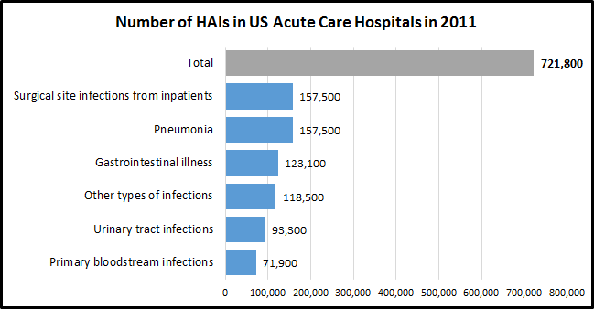
Cost Savings of $743,000 Per Year Per Hospital
Expected 30% reduction in HAI’s
Reduction of US HAI occurrences by 216,000 annually
Potential total cost savings of $4.3 billion in the US
  Average savings of $743K per year per hospital
Source: CDC
Notes:
The 30% Reduction is based on a study done in the UK on copper surfaces

Slide 9
What Makes Lumogenic Different?
 | Lumogenic | Metals (Cu, Ag) | UV-Treatment | Traditional Cleaning and Bleach
Efficient | ✔ | ✔ | X | X
Easy to Use | ✔ | ✔ | X | ✔
Large Area Coverage | ✔ | X | ✔ | X
Continuous Self-Cleaning | ✔ | ✔ | X | X
Limits Downtime | ✔ | ✔ | X | X
Non-Toxic | ✔ | ✔ | ✔ | X

Slide 10
Funding
Raw Materials
Direct Sales & Marketing
Lumogenic
Hospitals
Outsourced Manufacture
Continued R&D
Notes:
We have talked to you about the value of our product and we will get into some financials shortly, but I want to highlight some of the other components of our business model.
Outsourcing Options to consider:
PPG, Beneq Coating Services, Thin-Film Partners

Slide 11
Key Resources
Pre-seed
  Incubators
  Grants
Seed
  Angel investments
  Sales and marketing
  Manufacturing
Funding
Raw Materials
Direct Sales & Marketing
Metal foil
Titanium butoxide
Anhydrous ethanol
Glucose
Hexachloroplatinic acid
Lumogenic
Hospitals
Outsourced Manufacture
Continued R&D
Notes:
We have talked to you about the value of our product and we will get into some financials shortly, but I want to highlight some of the other components of our business model.
Outsourcing Options to consider:
PPG, Beneq Coating Services, Thin-Film Partners

Slide 12
Key Activities
Funding
Raw Materials
Direct Sales & Marketing
Common materials and processes
Limit our capital equipment costs
Lumogenic
Hospitals
Outsourced Manufacture
Continued R&D
CMU Islam Research Group
  Improve efficiency
  Reduce long-term costs
Notes:
We have talked to you about the value of our product and we will get into some financials shortly, but I want to highlight some of the other components of our business model.
Outsourcing Options to consider:
PPG, Beneq Coating Services, Thin-Film Partners

Slide 13
Customer Relationships & Channels
Funding
Raw Materials
Direct Sales & Marketing
Lumogenic
Hospitals
Outsourced Manufacture
Help mitigate barriers to entry
Relationships with local hospitals
Industry experience
Continued R&D
Notes:
We have talked to you about the value of our product and we will get into some financials shortly, but I want to highlight some of the other components of our business model.
Outsourcing Options to consider:
PPG, Beneq Coating Services, Thin-Film Partners

Slide 14

Purchase Model
One time purchase - Includes installation of wallpaper and stickers
Replacement of wallpaper and stickers every five years

Slide 15
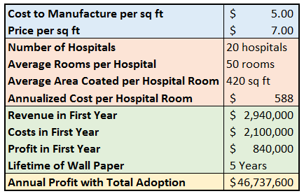
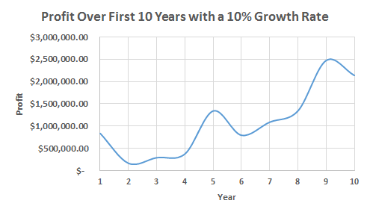
Financials
Notes:
Assuming we start with 20 hospitals, a 10% growth rate results in the following

Slide 16
Challenges and Barriers: Non-Market Analysis
Product must meet strict sanitation standards
  Benchmark is a 69% Reduction in CFUs within 5 minutes
Testing must confirm product claims
  Lifetime of 5 years
  Efficiency doesn’t degrade
Technical Risk
Hospitals are extremely RISK AVERSE
  Partner with a local hospital first to gain credibility
  Must significantly exceed other methods
Our profits are still an estimate
  Uncertainty in manufacturing costs
  Uncertainty in willingness to pay
Market Risk

Slide 17

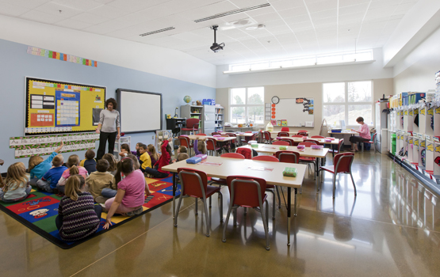
Opportunities for Future Growth
15,583 certified elder care and nursing facilities
90,000 elementary schools in the U.S.

Slide 18
$500K
$743K
$47M
Ask From SBIRs to Perform Infield Testing and Begin Early-Stage Manufacture
Benefit to Hospitals Per Year
Potential Annual Revenue
Harnessing the power of light to save money, save time, and protect lives

Slide 19








Our Team
Apurva Pradhan
MS Chemical Engineering
MS E&TIM
Nabeel Mohamed
MS Electrical and Computer Engineering
Candace Ogata
MS Materials Science & Engineering
Samer Abdelmoty
MS Mechanical Engineering
Daniel Peppler
MS Materials Science & Engineering
MS E&TIM
Notes:
We are looking for someone with medical sales experience

Slide 20



References and Acknowledgements
•Islam, M. et. al. Nano-photoelectrochemical Cell Arrays with Spatially Isolated Oxidation and Reduction Channels. ACS Nano. 2017, 11, 2150-2159
•Wilson, L. et. al. Multistate Point-Prevalence Survey of Healthcare-Associated Infections. N.Engl. J. Med. 2014. 370; 13.
•Stone, P. Economic Burden of Healthcare-Associated Infections: an American Perspective. NIH. 2009
•Douglas Scott, R. “Direct Medical Cost of Healthcare-Associated Infections in US Hospitals and the Benefits of Prevention”. Centers for Disease Control and Prevention. March 2009.
Special thanks to:
Dr. Mohammed Islam
Dr. Deborah Stine
Joe Hezir

Slide 21
APPENDIX

Slide 22
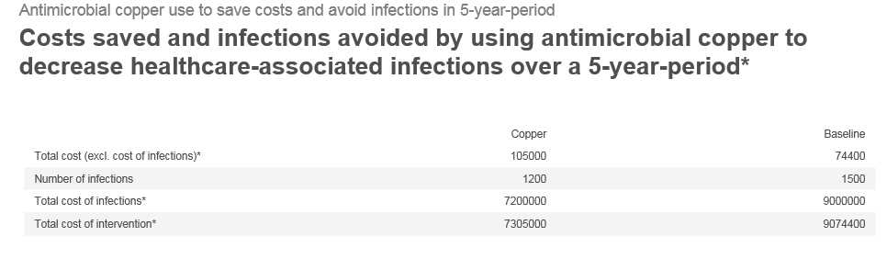
A 30% Reduction in HAI’s

Slide 23
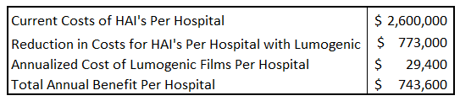
Value Proposition
For a Hospital with 50 rooms sized 225 sq ft.

Slide 24
Value Proposition
Indirect HAI Costs
CMS no longer reimburses hospitals for care provided to a patient who contracts an HAIs, which will impact many hospitals' bottom lines.
In 2014, it was predicted 2,225 hospitals would lose roughly $227 million in withheld compensation, ranging as high as $1 million in losses to some hospitals annually. In 2015, the penalty increases and reimbursement changes are predicted to cost a 300-bed hospital $1.3 million annually.
Indirectly, HAIs lead to a considerable financial burden and even bankruptcy for many patient families, as well as costs for medical malpractice cases and hospital liability.
https://www.medicalnewstoday.com/articles/80074.php
https://www.beckershospitalreview.com/quality/how-hais-lead-to-direct-indirect-and-unintended-hospital-costs.html

Slide 25
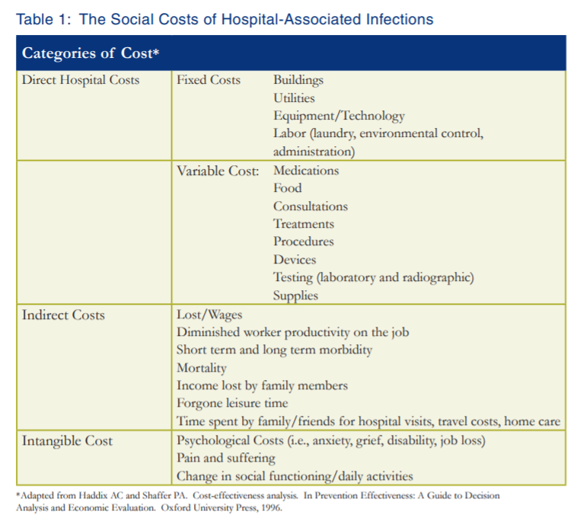

Slide 26
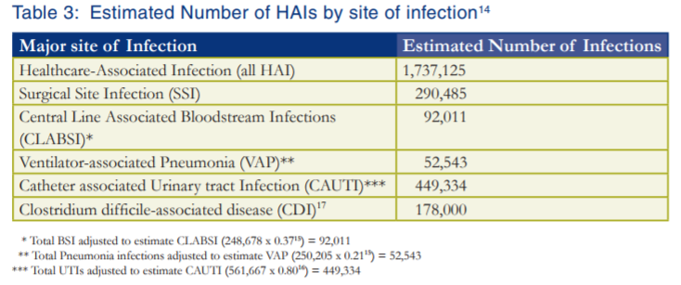

Slide 27
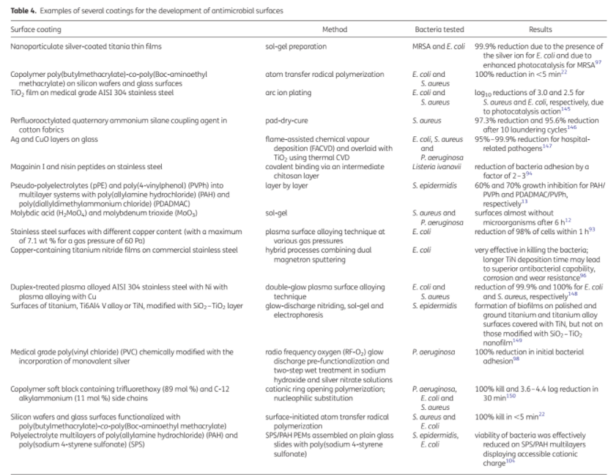

Slide 28
Initial Investment From Angel Investors or SBIRs
$500K
To perform infield testing and begin early-stage production

